Slide 1
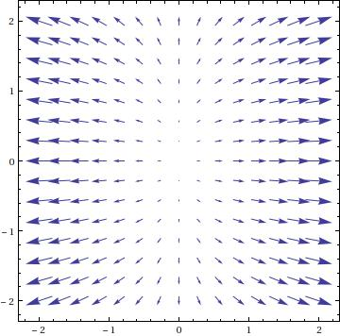
$$F\left(x,y\right)=<3x,y>$$

Slide 2
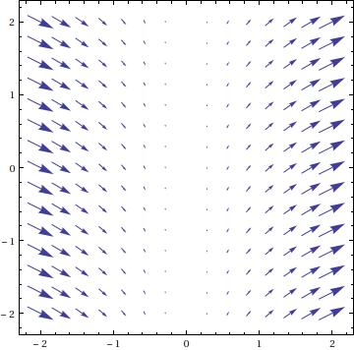
$$F\left(x,y\right)=<x^{2},x>$$

Slide 3
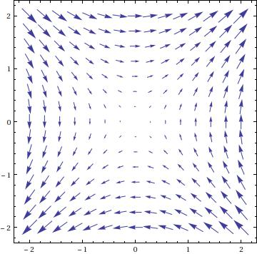
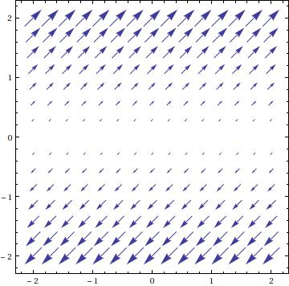
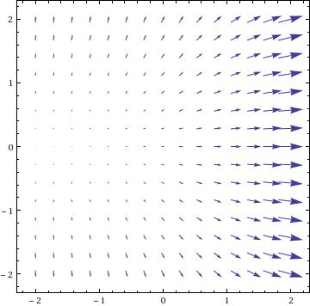
$F\left(x,y\right)=<y,y>$, $F\left(x,y\right)=<e^{x},y>$, $F\left(x,y\right)=<y,x>$

Slide 4
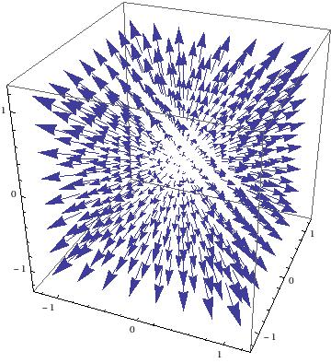
$$F\left(x,y,z\right)=<x,y,z>$$

Slide 5
We’ll now check out some other three dimensional vector fields using Mathematica.

Slide 6
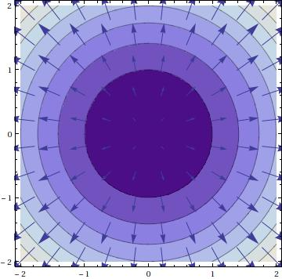
$$f\left(x,y\right)=x^{2}+y^{2}$$

Slide 7
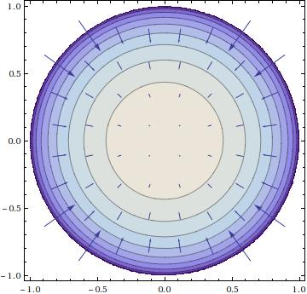
$$f\left(x,y\right)=\sqrt{1−x^{2}−y^{2}}$$

